Slide 1
Uber Trip Analysis & Forecasting
Leverage Uber's trip data for deeper insights and build robust forecasting models.
- Vaibhav Borkar

Slide 2
Introduction & Strategic Objective
Objective:
  Unlock actionable insights from Uber’s trip data to enhance operational efficiency and forecast demand.
Focus Areas:
  Data Analysis & Insights: Identify trip patterns, peak times, and vehicle utilization to optimize resources.
  Forecasting Models (ARIMA & Prophet): Predict trip volumes for smarter scheduling and resource management.

Slide 3
Data Overview & Preprocessing
Key Columns in Dataset:
  Dispatching Base: Uber base identifier
  Date: Trip date
  Active Vehicles: Number of vehicles available
  Trips: Total trips taken
Data Transformation & Feature Engineering:
  Date Conversion: Converted to datetime format for accurate analysis.
  Enhanced Features: Added Month, Day, Day of the Week, and Weekend to uncover daily and weekly trip patterns.

Slide 4
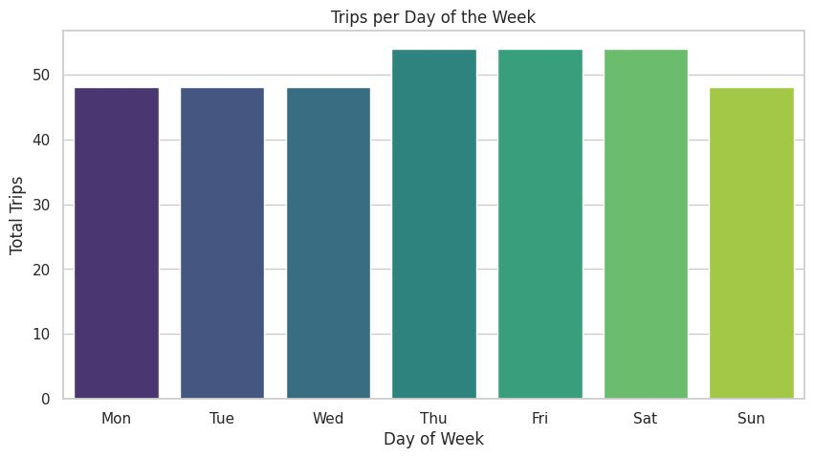
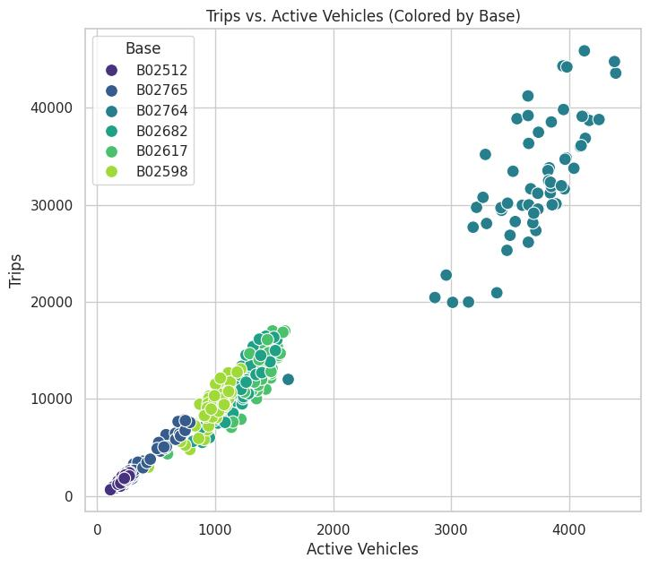
Trips & Active Vehicles - Insights
Trips by Day of the Week:
  Thursday, Friday & Saturday show significantly higher trip volume.
  Actionable Insight: Focus resource allocation and fleet deployment during peak weekend days.
Active Vehicles vs. Trips:
  Strong correlation between active vehicles and trip volume.
  Actionable Insight: Scale fleet size to meet demand spikes.

Slide 5
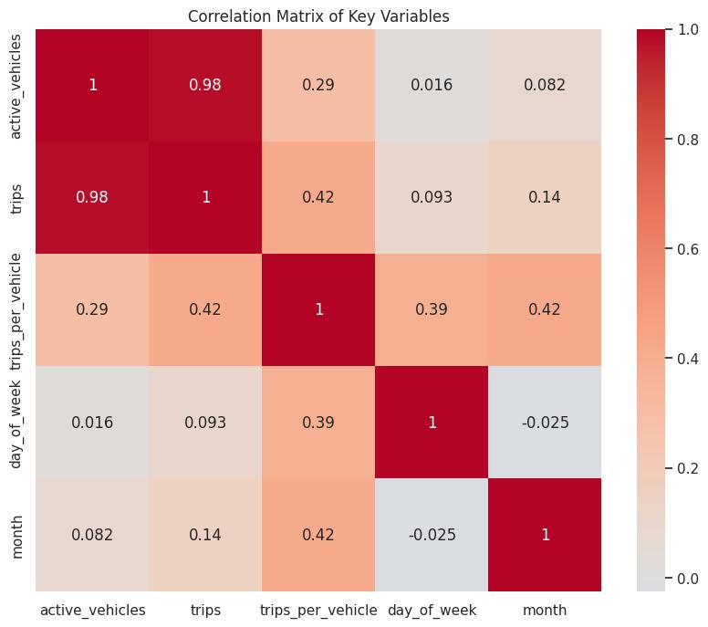
Correlation Matrix of Key Variables
Insight:
  Active Vehicles ↔ Trips: Strong positive correlation (0.98) — more active vehicles directly lead to higher trip volume.
  Trips per Vehicle ↔ Active Vehicles: Significant correlation — indicates that trip efficiency improves with more vehicles.
  Day of Week ↔ Trips: Moderate correlation — certain days (weekends) show higher trip volumes.
Actionable Insights:
  Fleet Planning: Use the number of active vehicles to predict and adjust for expected trip volume, ensuring resource availability during peak times.

Slide 6
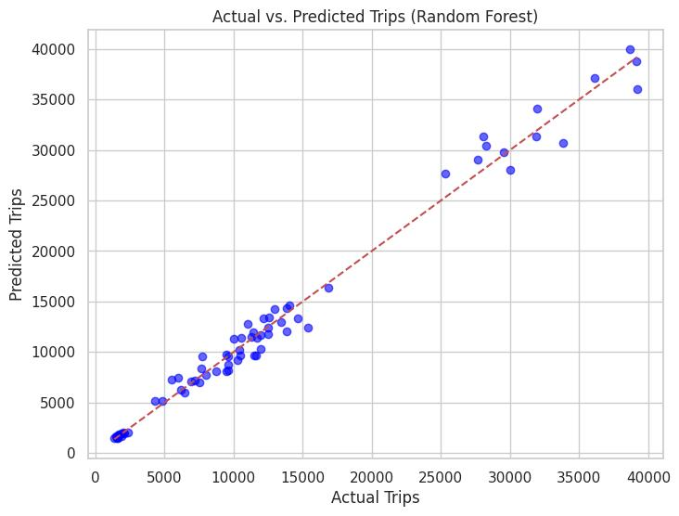
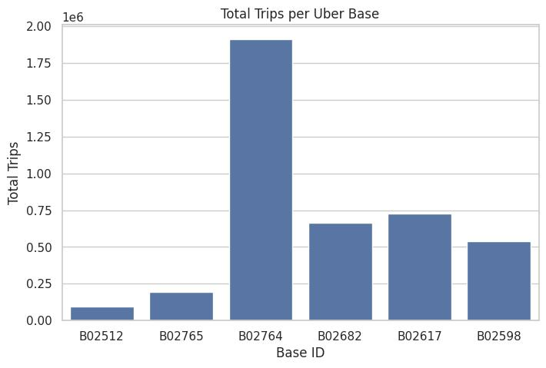
Uber Base Performance & Model Comparison
Total Trips per Uber Base:
  Varying trip volumes across different Uber bases.
Actionable Insight: Focus on optimizing resources for high-volume bases.
Model Performance:
  Random Forest Model:
    MSE: 1,513,379.90 | R²: 0.99
    Insight: Near-perfect prediction accuracy for trip forecasting.
  ARIMA & Prophet Models:
    ARIMA RMSE: 11,616.64
    Prophet RMSE: 11,131.81
    Insight: Both models offer strong predictions with Prophet handling seasonality better.

Slide 7
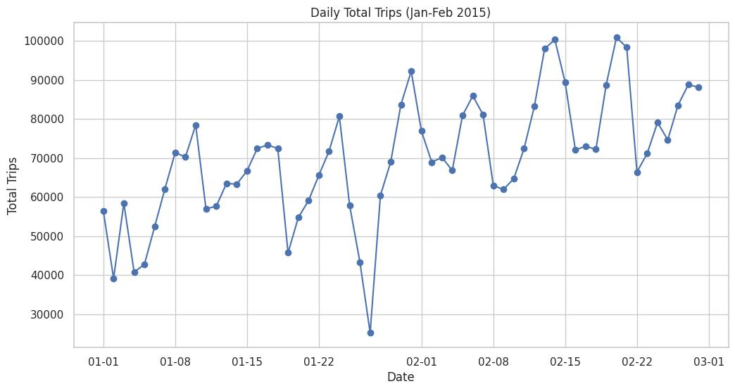
Time Series of Total Daily Trips
Insight:
  Shows overall trip trends from January to February 2015.
  Spikes in trips observed on weekends.
Actionable Insight:
  Forecast future trip volumes using time series models (ARIMA, Prophet).

Slide 8
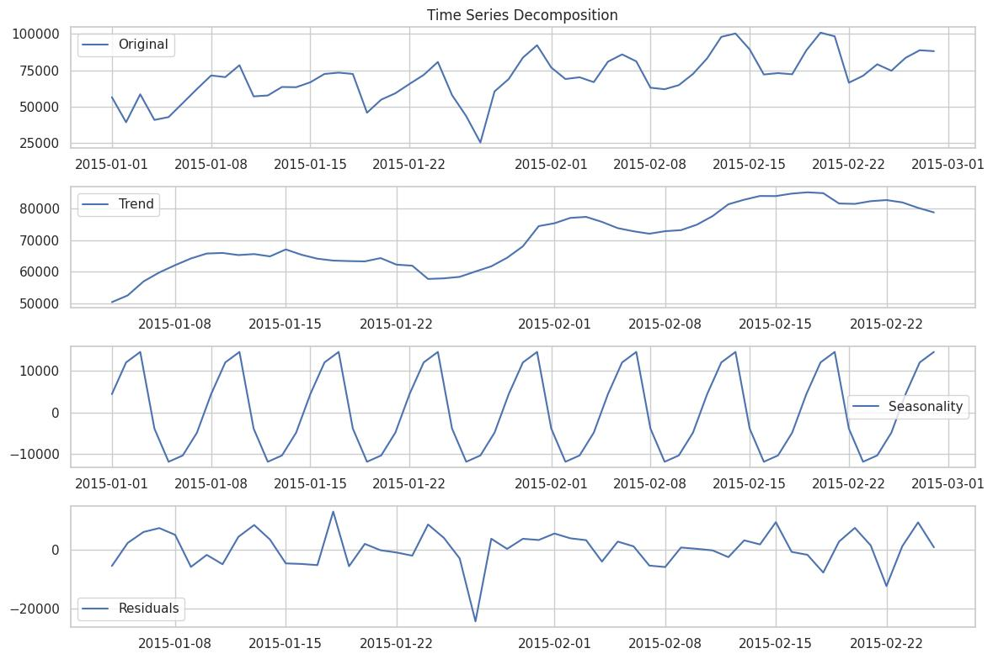
Time Series Insights & Decomposition
Key Insights:
  Daily Total Trips: Fluctuations in trips across days, with clear peaks and valleys.
Time Series Decomposition:
  Identified trend, seasonality, and residuals in the data.
Actionable Insight:
  Utilize seasonality data to optimize fleet allocation and improve forecasting.

Slide 9
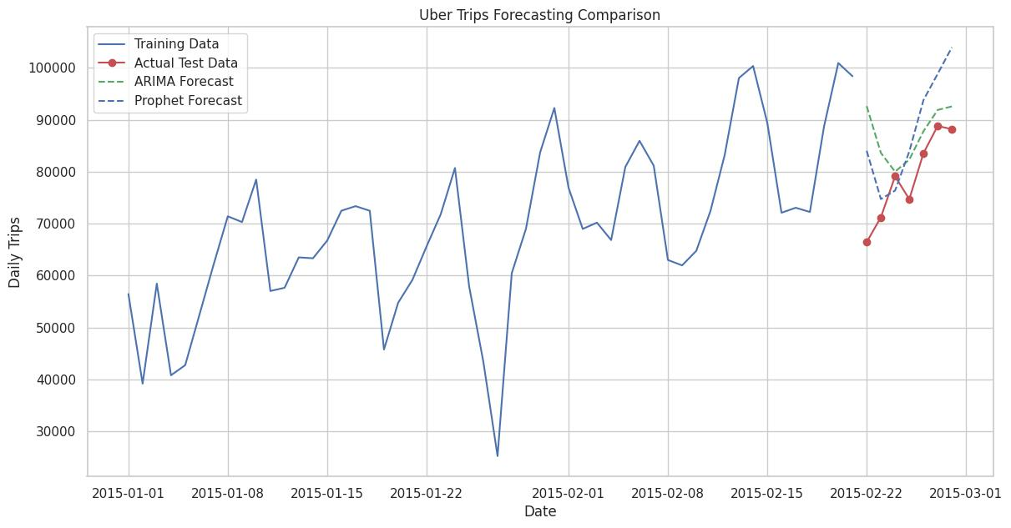
Final Forecasting Models & Future Strategy
Key Forecasting Models:
  ARIMA: Handles trend well, suitable for short-term predictions.
  Prophet: Handles both daily and weekly seasonality with high accuracy for long-term forecasts.
Next Steps:
  Continue refining the models for future predictions.
  Focus on weekly seasonality to improve fleet allocation.
  Monitor key variables like active vehicles and day of the week for resource planning.

Slide 10
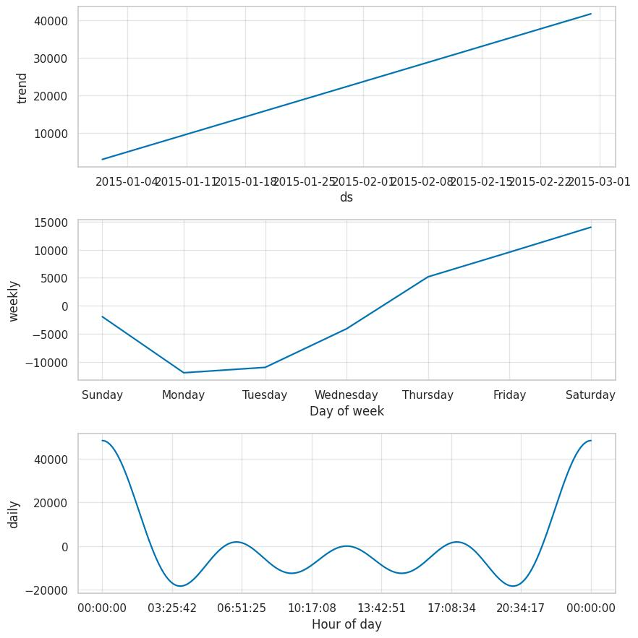
Conclusion & Actionable Insights
Key Takeaways:
  Significant correlation between active vehicles and trips.
Weekend demand is crucial—optimize fleet allocation accordingly.
  Forecasting models (ARIMA & Prophet) provide high accuracy—use for long-term planning.
Action Plan:
  Implement dynamic fleet management based on day-of-week and active vehicle demand.
  Refine forecasting models for improved accuracy in resource allocation and trip predictions.

